Slide 1
Applied Data Science Capstone Final Assignment Presentation

Slide 2
Introduction
This presentation is basically a part of final presentation that we have to provide for the completion of final assignment of week 5.
It will cover:
Business problem statement
Target Audience
Data Section
Application
Methodology
Visualization
Result and conclusion

Slide 3
Business Problem Statement
This project will analyze the New York City data.
To start with, we will find the most visited commercial shop in New York according to the number of check-ins to that shop.
Then we will try to find the neighborhoods that are lacking the selected type of shop which could be potential business opportunity,
and help the people to open shop in that area since these types of shops are not available.

Slide 4
Target Audience
The target audience of this report is any one that is interested in opening a shop but have no idea what kind of shop should he open and in which neighborhood.

Slide 5
Data Section
The data comes from Dingqi Yang from the following link:
https://sites.google.com/site/yangdingqi/home/foursquare-dataset.
It contains 227,428 check-ins in New York City. The data contains a file in .txt format.
Each file contains 8 columns, which are:
User ID (anonymized)
Venue ID (Foursquare)
Venue category ID (Foursquare)
Venue category name (Foursquare)
Latitude
Longitude
Time zone offset in minutes (The offset in minutes between when this check-in occurred and the same time in UTC)
UTC time

Slide 6
Application
We will find the most visited type of shop (commercial) according to the number of check-ins given in the data, then we will try to find neighbourhoods that has none of this type of shop.
Examples are for 2000 venues, and the red dot is the centre neighbourhood which has the most number of Bars between selected coordinates.
We did find two neighbourhoods that are closest to it having none Bars within 4 kilometres.

Slide 7
Methodology
After extracting and reading the data, we will translate the above data into a Pandas data frame for processing which would look like this.
These are the data elements that are needed when we call Foursquare web service call in order to get the venues available in that neighborhood
Then we will create a dictionary in order to decide which category is the most popular (commercial type)
After all this, we will check the coordinates within given n number of kilometers and count how many ‘Bar’ are there (venues selected as 2000 as a trial)
Find the two neighborhoods that are closest to the coordinate which has the most number of the specific shop type but lacking that within 4 kilometers

Slide 8
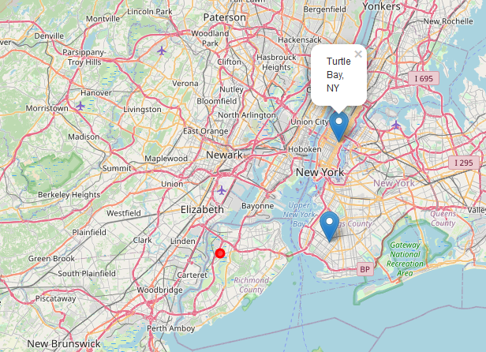
Visualization (1/3)

Slide 9
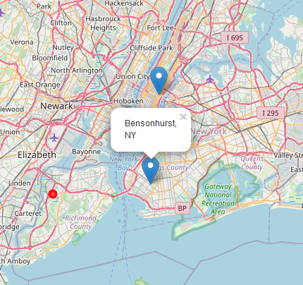
Visualization (2/3)

Slide 10
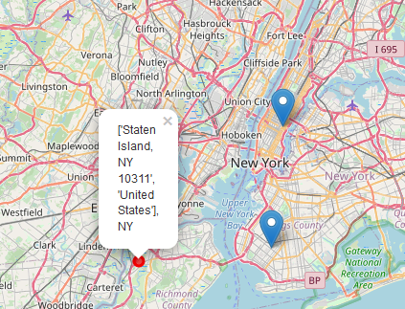
Visualization (3/3)

Slide 11
Results & Conclusion
In our sample of 2000 venues, we did find more than 10 coordinates that has no Bar (the most visited shop type according to sample) within four-kilometer sphere.
And we did manage to get the neighborhoods’ names from foursquare database and pin down the two closest neighborhoods, ‘Bedford-Stuyvesant’, and ‘Turtle Bay’, into the map.
Of course, it should not be forgotten that the data used above is almost 6-year old so further research might be needed.
Anyways, the results according to the data in hand can be checked from the map and analysis above can be of use for future entrepreneurs.

